Slide 1
Classical Cryptosystems And Java

Slide 2
Overview
Arrays and Indexing
ASCII & Unicode
For Loop

Slide 3
ARRAYS
An array is a container object
that holds a fixed number of
values of a single type

Slide 4
arrays
Index into an array
[0][1][2][3][4][5][6]…

Slide 5
String as an array of characters
Character[13] cryptoArray = CRYPTOSYSTEMS
[C] [R] [Y] [P] [T] [O] [S] [Y] [S] [T] [E] [M] [S]
[0] [1] [2] [3] [4] [5] [6] [7] [8] [9] [10][11][12]
cryptoArray[8] = S

Slide 6
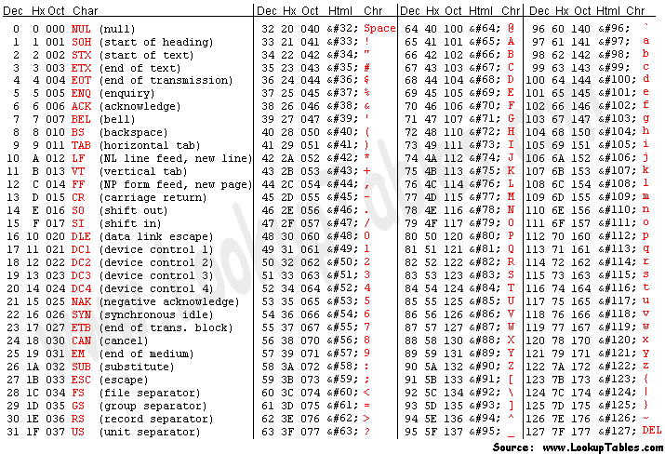
ASCII American Standard code for information interchange

Slide 7
Construct a character
65 => A 90 => Z
char(65) => A char(90) => Z
97 => a 122 => z
char(97) => a char(122) => z

Slide 8
One-way function in java
char(65) = A char(97) = a
char(90) = Z char(122) = z
getNumericValue(A) ≠ 65 getNumericValue(a) ≠ 97
getNumericValue(A) = 10 getNumericValue(a) = 10
getNumericValue(Z) = 35 getNumericValue(z) = 35

Slide 9
Use with %
% = mod
a = 10, A = 10 z = 35, Z = 35
a % 26 => 10 mod 26 => 10
z % 26 => 35 mod 26 => 9
(a-10) % 26 => (10 – 10) mod 26 => 0
(z-10) % 26 => (35 – 10) mod 26 => 25

Slide 10
OFFSet
Unicode a = 97
Value a = 10
Value a – 10 = 0 (so we can use %)
offset = 97 – 0 = 97
char(valueA – 10 + offset) = char(97) = a

Slide 11
for loop AKA conditional loop
int i = variable that holds an integer.
i is the convention in for loops. Stands for increment.
for (where we start; where we end; how we get there);
for (int i = 0; i < 10; i++);
for(int i = 10; i > 0; i--);

Slide 12
For loop
for (int i = 0; i < 3; i++) {
System.out.println(i);
}

